Slide 1
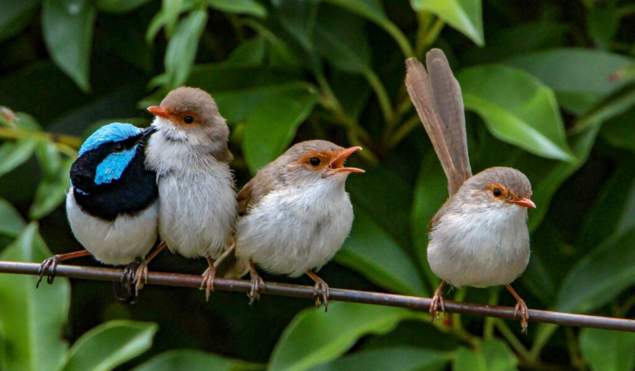
Angela R. Brierly School of Biological Sciences Ecology & Evolutionary Biology Shizuka Lab
What are the fitness consequences of Cooperative Breeding
and how did it evolve?
Photo by Sandra Gallienne via eBird (https://macaulaylibrary.org/asset/86886001)

Slide 2
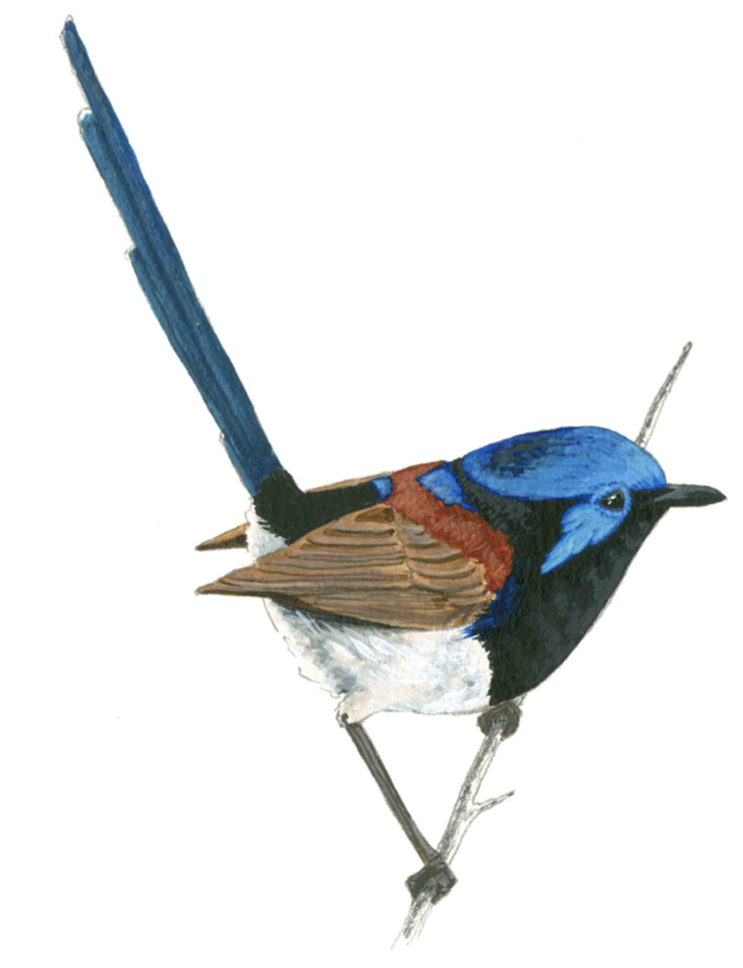
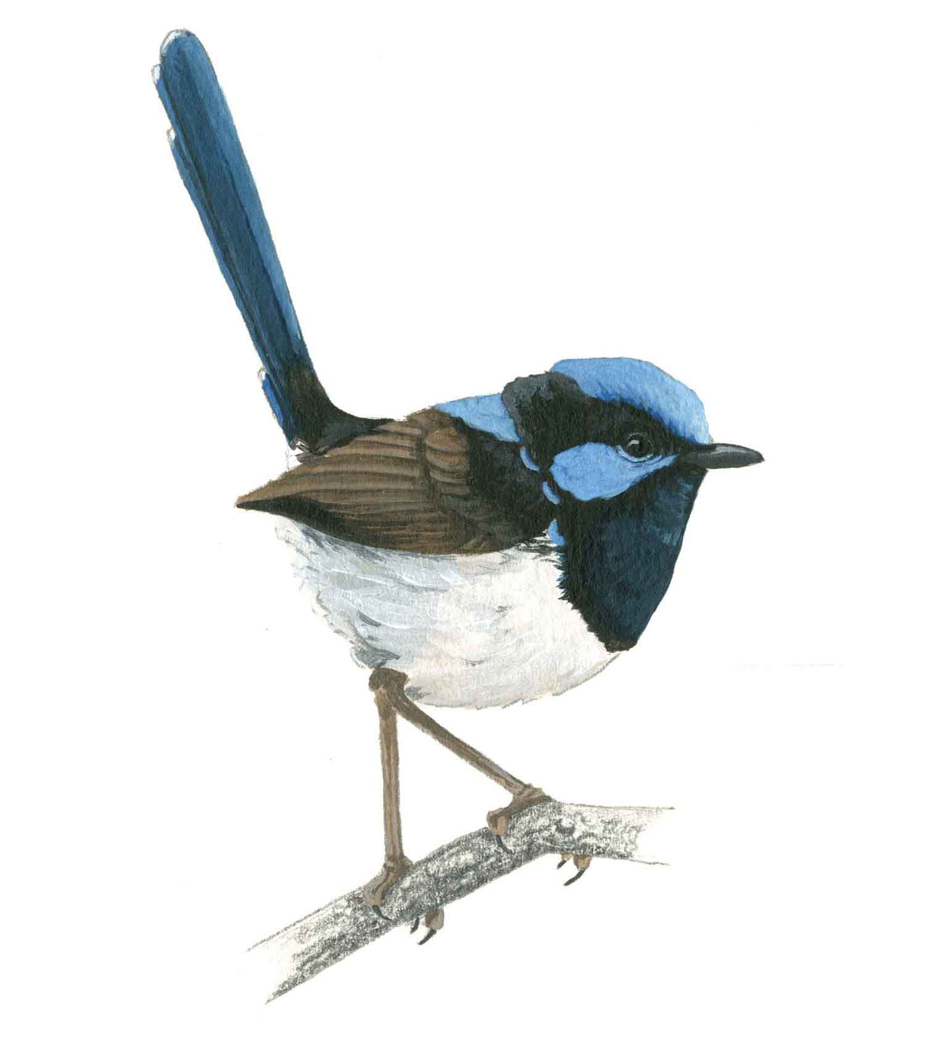
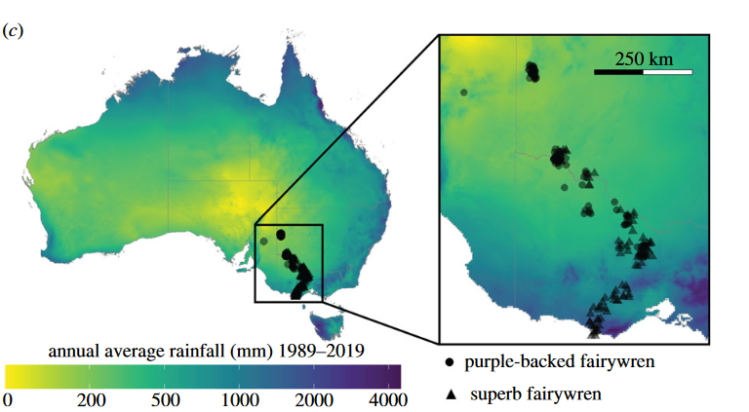
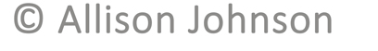
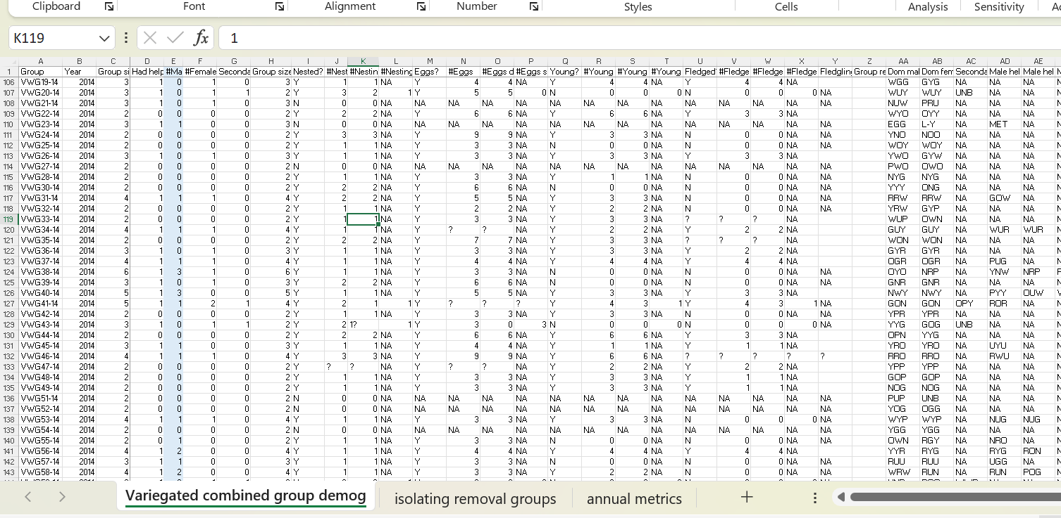
Fairywren Social Data
Environmental Data
Social Network
Fitness (surviving offspring)
Demographics, Group Size
Rainfall
Habitat Quality (insect abundance, foliage)
Ecological Gradient Transect
Johnson AE, Welklin JF, Hoppe IR, Shizuka D. 2023 Ecogeography of group size suggests differences in drivers of sociality among cooperatively breeding fairywrens. Proc. R. Soc. B 290: 20222397

